Slide 1


<NIEM>
Immigration Domain Update
Domain Stewards:
Jennifer Kish (Office of Immigration Statistics – IDII Data Governance Chair)
Curtis Ross (Office of Immigration Statistics – Enterprise Standards Lead)
October 21st 2019
Draft
1

Slide 2
2019 Highlights: “NIEM-First” Policy
David P. Pekoske, Senior Official Performing the Duties of the Deputy Secretary, of the Department of Homeland Security (DHS) signed the "NIEM first" memorandum on May 3rd, 2019 outlining the Department's adoption of the National Information Exchange Model (NIEM).
The Under Secretary for Management (USM) and DHS Chief Information Officer will take actions to:
Require that all future, major information technology (IT) acquisitions, include in their requirements conformance with the latest version of NIEM and alignment to one or more governed NIEM domains;
Ensure that legacy data exchanges be exempt from this requirement
Provide for an exceptions mechanism that may allow for new, non-NIEM conformant data exchanges to be created;
Ensure NIEM First is enforced by the Program Accountability and Risk Management Division, of the USM, in coordination, as appropriate and required, with the Offices of the General Counsel, DHS Privacy, and DHS Civil Rights and Civil Liberties;
Undertake whatever routine and ongoing outreach and communications required to all DHS internal and external stakeholders, to ensure understanding of and concurrence with this new requirement.
NIEM FIRST MEMORANDUM

Slide 3
2020 Objectives: NIEM Immigration domain Standard Development and Application
Application of the OIS Immigration Data Integration Initiative (IDII) Authorities to Support the NIEM-First policy with in the Immigration Domain
IDII Background: OHS Memorandum 16-3048, "Improving Immigration Data Analysis and Reporting," directs the Office of Immigration Statistics (OIS) to work with the Office of the Chief Information Officer(OCIO) and the Department's Components to develop a more fully integrated immigration data environment and to strengthen the Department's systems for analyzing and reporting on immigration data. The memo further directs OIS and OCIO to establish and co-chair the IDII ESC.
Activities:
Governance development, and application of the Enterprise Immigration Domain Standards (DGWG)
Policy oversight and development supporting the governance activities (POWG)
Capability and Implementation Working Group (CIWG) – IDII Data Sharing Framework and Data Model development
Authoritative Source Data Toolset Development
Data Change Request (DCR) – Enterprise Standards Change Management Vetting Tool
Collibra Data Governance Center Supporting Collaborative Definition of Domain Data Assets

Slide 4



Expansion of the Stewardship Model Appointing Business SMEs over Domain Asset Types
All formally appointed stewards under the Immigration Domain operate under the authority of Deputy Assistant Secretary of the DHS Office of Strategy, Policy, and Plans, Office of Immigration Statistics.
DHS Country Steward: Curtis Ross (OIS)
ICE Detention Locations Stewards:
Judy Thomas (ICE) & Donna Vassilio (ICE)
ICE ERO and g287 Sites Steward:
Kevin Wetzel (ICE)
USCIS Locations Steward: Mike Manning (USCIS)
DHS Biographic Stewards: Kerstin Jager (USCIS) / Michele Steinmetz (OIS)
Vessel Steward: LT Kenny Miltenberger (USCG)*
DHS Language Type Steward: Lynn Thai (USCIS)
DHS Address Steward: Phil Markert (USCIS)
USCIS Locations IRIS Steward: Mike Quinn (USCIS)
USCIS Locations FOD Steward: Dawn McLaren (USCIS)
USCIS Application Support Center (ASC) Steward: Michael Boyajian / Brandi Berry (USCIS)*
Port of Entry Steward: Jennifer Kish (OIS) Interim Religion Type Steward: JP Saunier (USCIS)*
USCIS Locations Asylum Interview Locations Steward:
JP Saunier (USCIS)*
ICE Case Category Codes Steward: Kevin Wetzel (ICE)*
6. Employment Authorization Document Types (EAD) Steward: _{18.}
Jerry Rigdon (USCIS)
DOS Consular Standard Steward: Gary Gray (USCIS)
DHS Class Of Admission Steward: Tara Webster (USCIS)
EOIR Immigration Courts Steward: Mark Pasierb and David Fruehwald (DOJ)
History Action Codes (HAC) Steward: Heather Holick
(USCIS)
*New stewards or stewards going through the formal appointment process.

Slide 5
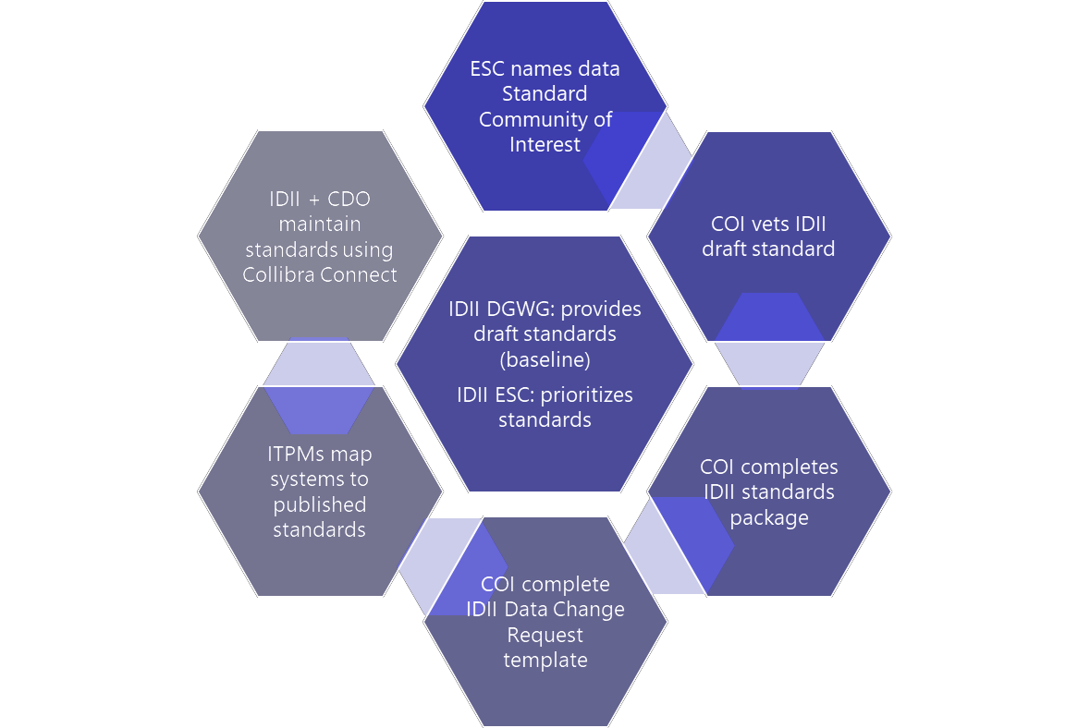
IDII Data Standards Implementation Plan

Slide 6
Immigration Domain Needs To Support Further Development
NIEM Program Office support to with sharing the NIEM-JSON implementation strategy we can share with the Immigration Domain community
Coordination with our IDII Capability and Implementation Working Group led by Data Services Division (DSD)

